Slide 1
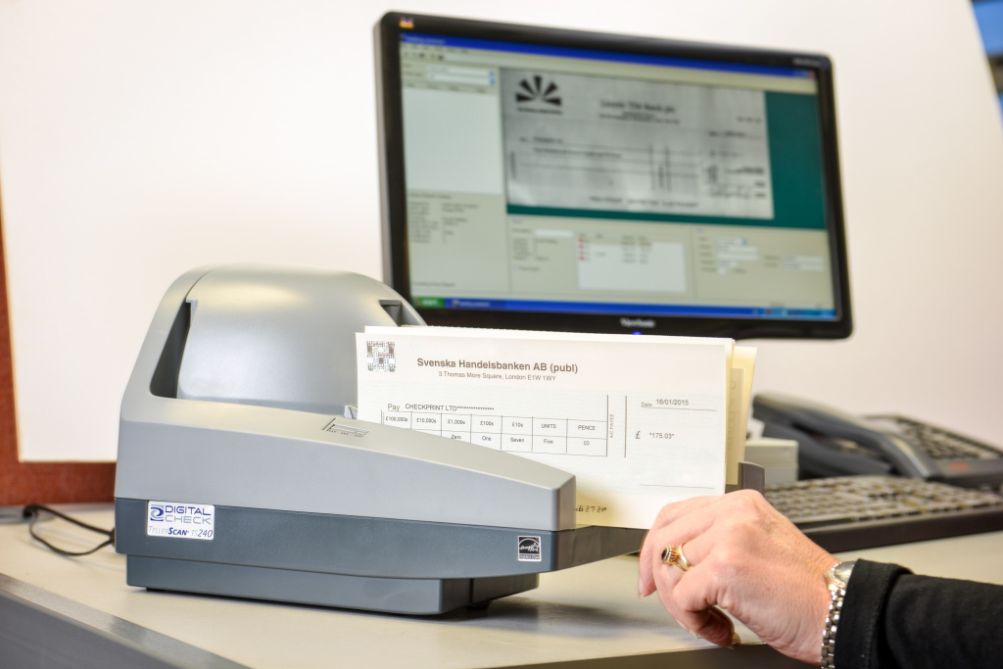
Cheque Clearing

Slide 2
Cheque
A cheque is a negotiable instrument instructing a financial institution to pay a specific amount of a specific currency from a specified transactional account held in the drawer's name with that institution. Both the drawer and payee may be natural persons or legal entities. Cheques are order instruments, and are not in general payable simply to the bearer as bearer in instruments are, but must be paid to the payee.
The four main items on a cheque are
Drawer – the person or entity who makes the cheque
Payee – the recipient of the money
Drawee - the bank or other financial Institution where the cheque can be presented for payment
Amount – the currency amount

Slide 3
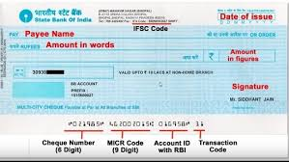
MICR – Magnetic Ink Character Recognition
MICR (Magnetic Ink Character Recognition) code is a machine readable code used for processing and clearance of cheques. It is used to identify the bank branch to which the cheque belongs. When a cheque goes for clearing, this code is read by a magnetic reader and then automatically sorted. MICR technology speeds up the whole process compared to manual reading and sorting.
An MICR code is a 9-digit code that
uniquely identifies the bank and branch
participating in an Electronic Clearing
System (ECS). It comprises of 3 parts:
The first three digits represent the city
(City Code). They are aligned with the
PIN code we use for postal addresses
in India.

Slide 4
Demand Draft
A demand draft or a DD is a negotiable instrument issued by the bank. The meaning of negotiable instrument is that it guarantees a certain amount of payment mentioning the name of the payee. It cannot be transferred to another person in any situation.
The bank issues the draft to a client (drawer) directing another bank or own branch to pay the specific amount to the payee. Demand drafts can be compared to cheques but these are hard to counterfeit and more secure. This is because the drawer has to pay before issuing a demand draft to the bank whereas cheque can be issued without ensuring the sufficient funds in your bank account. Therefore, cheques can bounce but drafts assure a safe and on-time payment.
The drafts are payable on demand. It cannot be paid to the bearer but the beneficiary has to present the instrument directly to the branch. It can also be collected by the clearing mechanism of the bank. Mostly, demand drafts are issued in situations where the parties are unknown to each other and lack trust. It comes handy in such situations as there are almost no chances of fraud and counterfeiting.

Slide 5
Cheque Truncation System
Truncation is the process of stopping the flow of the physical cheque issued by a drawer at some point with the presenting bank en-route to the drawee bank branch. In its place an electronic image of the cheque is transmitted to the drawee branch by the clearing house, along with relevant information like data on the MICR band, date of
presentation, presenting bank, etc.
Electronic images of the cheques are captured for processing
The MICR data in the cheques will be captured as present on MICR band
Amount is captured manually
Captured images along with the data are exchanged across the banks
The images and data are getting transmitted over the secured network
The Settlement of the CTS happens on the basis of MICR data captured from the cheques
Physical cheques are retained at the presenting bank itself.
In Cheque Truncation System we have two types of Clearing
Outward Clearing
Inward Clearing

Slide 6
Benefits of Cheque Truncation System

Slide 7
Cheque Truncation System Flow

Slide 8
Outward Clearing
Outward clearing means the cheques sent for collection. When a particular branch receives instruments drawn on the other bank within the clearing zone and sends those instruments for collection through the clearing arrangement is considered as Outward Clearing for that particular branch. In outward clearing bank plays role of presenting bank.
Example :
Customer holds an account with HDFC bank he receives a cheque worth INR 10,000 from his company and the cheque is drawn ICICI bank. Now customer needs the cheque to be cleared. Customer visits HDFC bank and deposit the cheque in account by updating cheque deposit slip with cheque details. HDFC bank will process the cheque through Outward Clearing by scanning the cheque to be send to ICICI

Slide 9
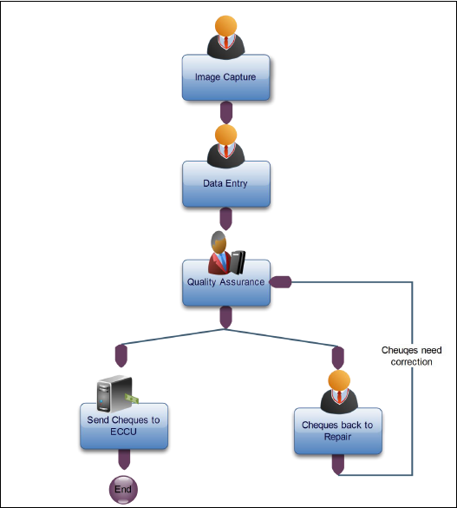
Outward Clearing Workflow

Slide 10
Image Capture: Teller captures the cheques face and back images and create batches to keep the scanned cheques inside them.
Data Capture: Teller updates reviews cheque MICR details are captured and update the customer account and amount of the cheque.
Quality Assurance: Where Supervisor verify the batch scanned and data input in cheque details is complete and correct. If Data mentioned is correct then the batch is send to Replied Cheque. If Data mentioned in cheque is incorrect Supervisor should flag the cheque for repair/ rescan.
Repair / Rescan: Teller verify the cheque details and do necessary correction if it needs to be repaired. Once cheque is repaired it move to Quality Assurance for approval Or if the cheque is not scanned properly teller delete cheque and rescan in Image Capture.
Replied Cheques: Cheques which are approved by Supervisor move to Replied cheques and then cheques are send to Central Bank which then Central Bank route the cheque to respective banks

Slide 11
Don’t Outward Clearing
1) Don’t wait for the last minute to complete the processing of instruments. If for some reason if the network fails then it will be difficult to complete the processing.
2) Don’t process any instrument which looks suspicious without further investigation.
3) Don’t process any instrument which does not conform to the image specifications without keeping them separately for physical presentment.
4) Don’t process an instrument which is materially altered as it will get returned.
5) Don’t keep the return marking pending beyond the session validity period as returns can’t be marked beyond the validity time.
6) Don’t process a paid instrument or duplicate file, ensure internal controls are in place
for handling this.
7) Don’t process any instrument which is scanned beyond the time limit specified by Clearing House

Slide 12
Inward Clearing
Bank receives inward cheques from other banks through Clearing. The Inward clearing starts when the paying bank receives cheques from Clearing house. Cheques will pass through series of validation process which certify them against the banks standards and principles. In Inward clearing bank plays roles of Paying Bank.
Example:
When Paying Bank ( HDFC) receives cheques from other banks through Inward Clearing. Bank verify cheque details and debits the customer account in order or return the cheque with return reason

Slide 13
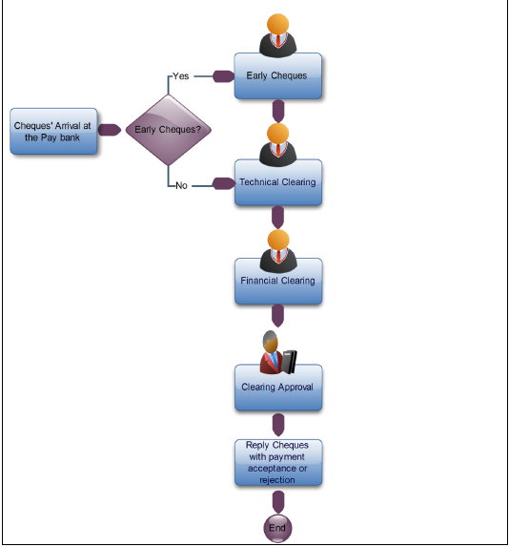
Inward Clearing Workflow

Slide 14
Early Cheques: Cheques received after cut off time is parked in early cheques que. This will be automatically released to Technical Clearing Option after EOD.
Technical Clearing: Teller verifies the inward cheques such as Date, Amount in Words & Figures, Signature. If the cheque is in order it moves to Financial Clearing . If the cheque is not in order teller can mark the return reason and its moves to Clearing Approval
Financial Clearing: Cheques which have been cleared from Technical clearing moved to Core Banking system and accounts are debited if funds available. Then Cheques will be tagged as Paid moved to Replied Cheques where notification will be send to Central Bank. If funds not available cheques move to Clearing Approval
Clearing Approval: Checker reviews cheque and pass if required or return the cheque with respective return reason and it will move to Replied Cheques
Replied Cheques: Cheques with Paid and return status are send to Central bank

Slide 15
Return Reasons for Cheque Truncation System
Below cheque return reasons for Cheque Truncation System
Insufficient Funds
Effects not cleared , present again
Drawer’s signature incomplete
Drawer’s signature differs
Drawer’s signature required
Alteration require drawer’s authentication
Payment stopped by drawer
Payment stopped by court order
Post Dated Cheque
Stale Dated Cheque
Cheque irregularly drawn/ amount in words and figures differ
Not Drawn on us
Account Closed
Account Blocked

Slide 16
Accounting Entry for Outward Clearing
Accounting Entry for Outward Clearing
Cheque Deposit
Debit Suspense A/C
Credit Customer A/C
Accounting Entry for Outward Return Clearing
Cheque Deposit
Debit Suspense A/C
Credit Customer A/C
Cheque Deposit Return
Debit Customer A/C
Credit Suspense A/c
( Cheque Return Reason)

Slide 17
Accounting Entry for Inward Clearing
Accounting Entry for Inward Clearing
Inward Debit
Debit Customer A/C
Credit Suspense A/C
Accounting Entry for Inward Return Clearing
Inward Debit
Debit Customer A/C
Credit Suspense A/C
Inward Return
Debit Suspense A/C
Credit Customer A/c
( Cheque Return Reason)
Inward Return Charges
Debit Customer A/C
Credit Commission A/C

